Slide 1
超越学科界限的认知基础 Transdisciplinary Cognitive Foundation Week 1 A Foundation Grounded on Encoded Symmetries
Ben Koo
September 15, 2021

Slide 2
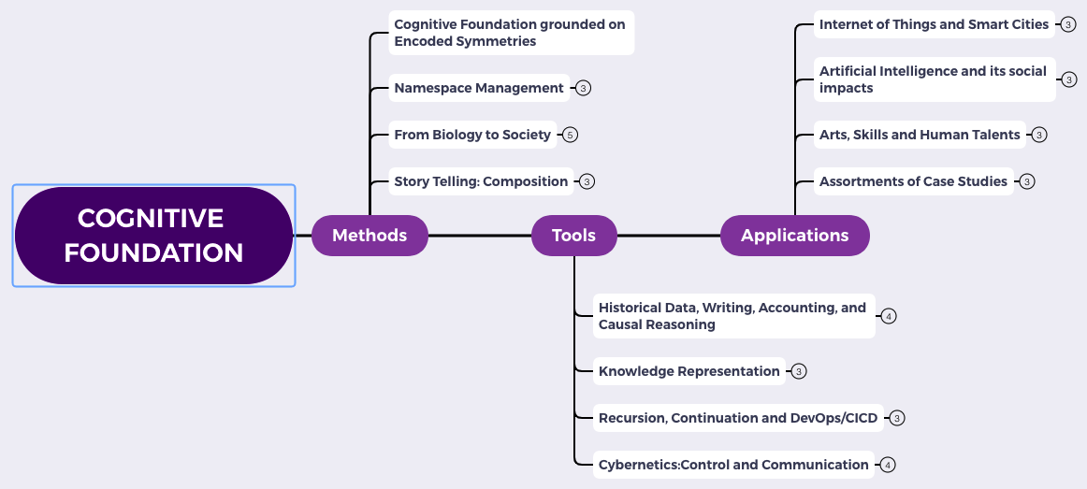
Content Themes for the semester
Overview
Namespace Management
Biology, Physics, Math, Code is Law, and Society
Story Telling, Functions/Metaphors/Analogies
Writing, Accounting, Historical Data and Temporal Reasoning
Knowledge Representation in Wiki and Files
Recursion and Continuation (DevOps/CICD)
Midterm Reports by Students
Cybernetics (Control and Communication)
Smart City and Internet of Things
Artificial Intelligence and its Social Impacts
Arts/Skills/Human Talents in the Digital Era
Student proposed Application Topics
Rehearsal
Final Reports and Celebration

Slide 3
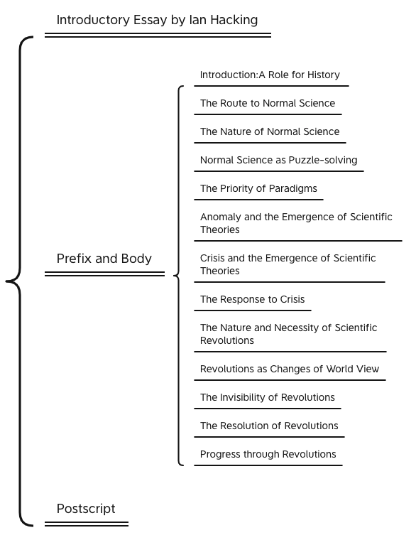

A classic that paved the road for many

Slide 4
Why did the book started with History?
What sciences were mentioned?
Who is Ian Hacking?

Slide 5
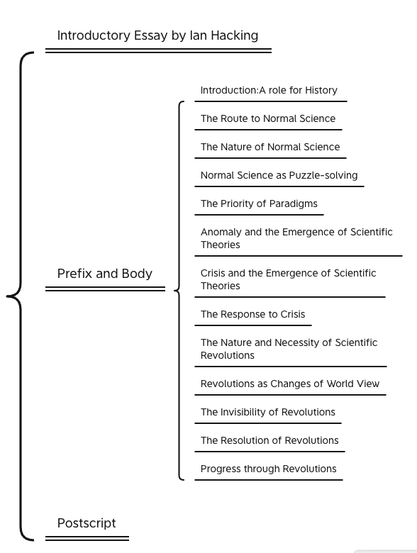
Key Ideas in Kuhn’s Dictionary
Incommensurable
不可通约的
Anomoly
Pre-Science
Normal Science
Puzzle Solving
Model Crisis
Model Revolution
Paradigm Change
Original Diagram from: https://www.thwink.org/sustain/glossary/KuhnCycle.htm

Slide 6

Kuhn Cycle in the Big Data-AI Era
Normal Operations
Drifting Norms
Operational Crisis
User Revolution
Version Upgrade
Emerging cases or
systematic attacks

Slide 7
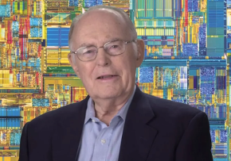
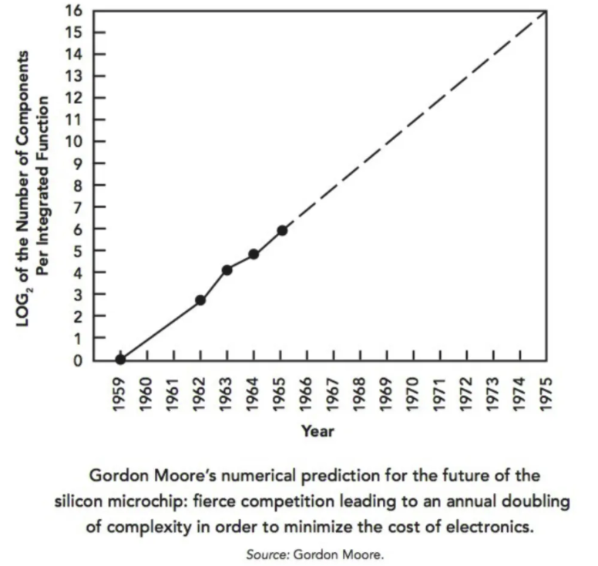

The Secret of Information Asymmetry
Before Moore, Data was dimensionless...
Space
What these top billionaires have in common that everyone else does not know.
by Vivek Sakpal May 19, 2018
Time
Moore provided the measurable strategy for executives that connected from socio-economic systems to quantum physics, and data sciences...
Moore’s Law is a sound Roadmap that associates physical dimensions with Data.
Notes:
How Startups from silicon valley disrupted the F500 with exponential growth
WHY did they succeed: Because they rely on a new paradigm which is moores law

Slide 8
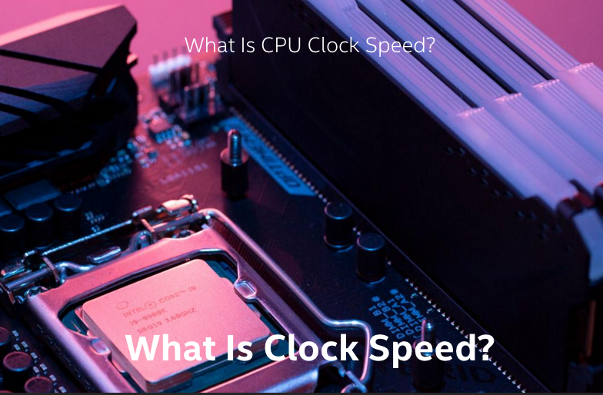
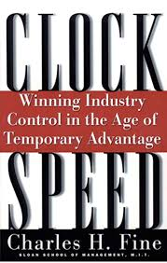

Societal Clockspeed determines how People Think

Slide 9
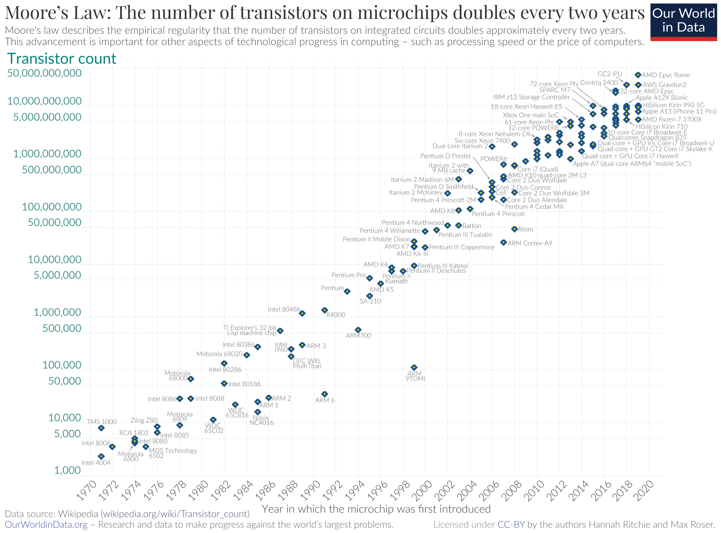

Moore’s Law as a symmetry in Innovation
Exponential Growth is a kind of Invariant
Image Source: Wikipedia
Notes:
Organise data to enable Security, Processing, Deployment
(notes) tensor flow logo??
Companies are using cloud services to gain access to tools that will hopefully improve their efficiency and ability to profit from Data; however, most companies do not have proper Namespace Management (NsM) so therefore the current methods of managing Data Assets, are complex, costly, and most importantly causing data to be a liability and not an asset.

Slide 10
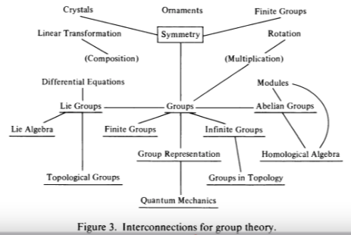
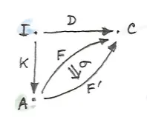
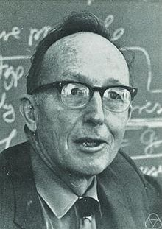
Symmetry/Invariance and Representable Closure
All concepts are Kan Extensions!
Kan Extensions Diagram
by Milewski
Page 425 of Mathematics: Form and Function by Saunders MacLane
Notes:
Organise data to enable Security, Processing, Deployment
(notes) tensor flow logo??
Companies are using cloud services to gain access to tools that will hopefully improve their efficiency and ability to profit from Data; however, most companies do not have proper Namespace Management (NsM) so therefore the current methods of managing Data Assets, are complex, costly, and most importantly causing data to be a liability and not an asset.

Slide 11

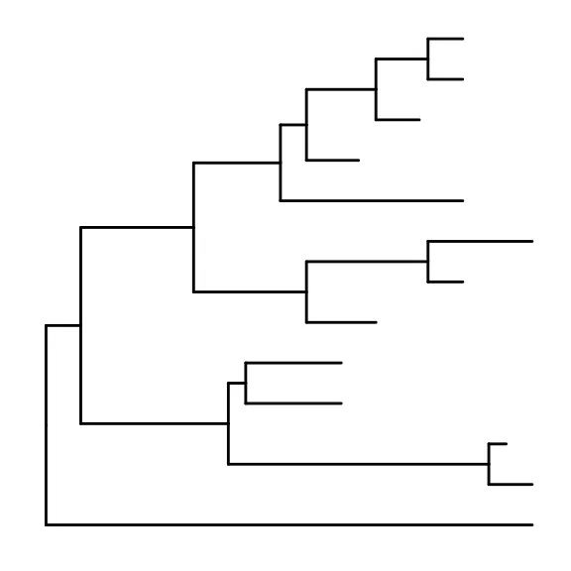

Data : Relations in Spacetime
Time
Data 2
Data 3
Data 1
Data: a discrete piece of evidence that proposes or breaks information symmetry based on previously available data.
Scott’s first axiom:
A data type is a partially ordered set (Poset).
Excerpt from: Outline of a Mathematical Theory of Computation
Space
Data 0
(Encoding Standards: all data can be encoded as Poset.)

Slide 12

The Soundness of Causal Data in Physical Space
Future
Present
Moment
Image Source: Wikipedia on light cone
Past
Private Space
Public Space
Public
Space
Spaces of Influences

Slide 13








A Roadmap for navigating Data in Spacetime
Future
Deployment
Present
Processing
Past
Public
Private
Public
Space of Data Privacy

Slide 14
The Science of Data Governance
Operating System: a platform for data processing
Notes:
(notes)
Make sure that they understand that working with the three challenge projects is to show them that all these principles exist in these organizations. We change the way they view the world so they can solve problems in their own environments
Page services files
Dev Sec Ops
Tools
Work flow

Slide 15
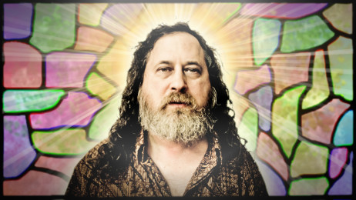
The One Hacker that Governed most of our Data
Richard Stallman
Founder of Free Software Foundation
Creator of GNU/Linux

Slide 16
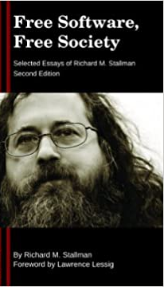
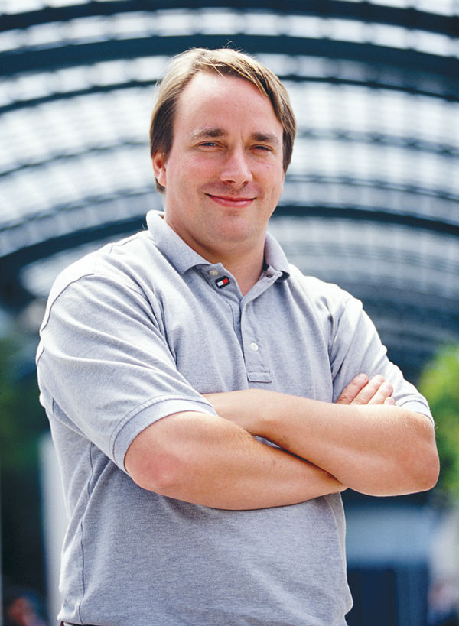
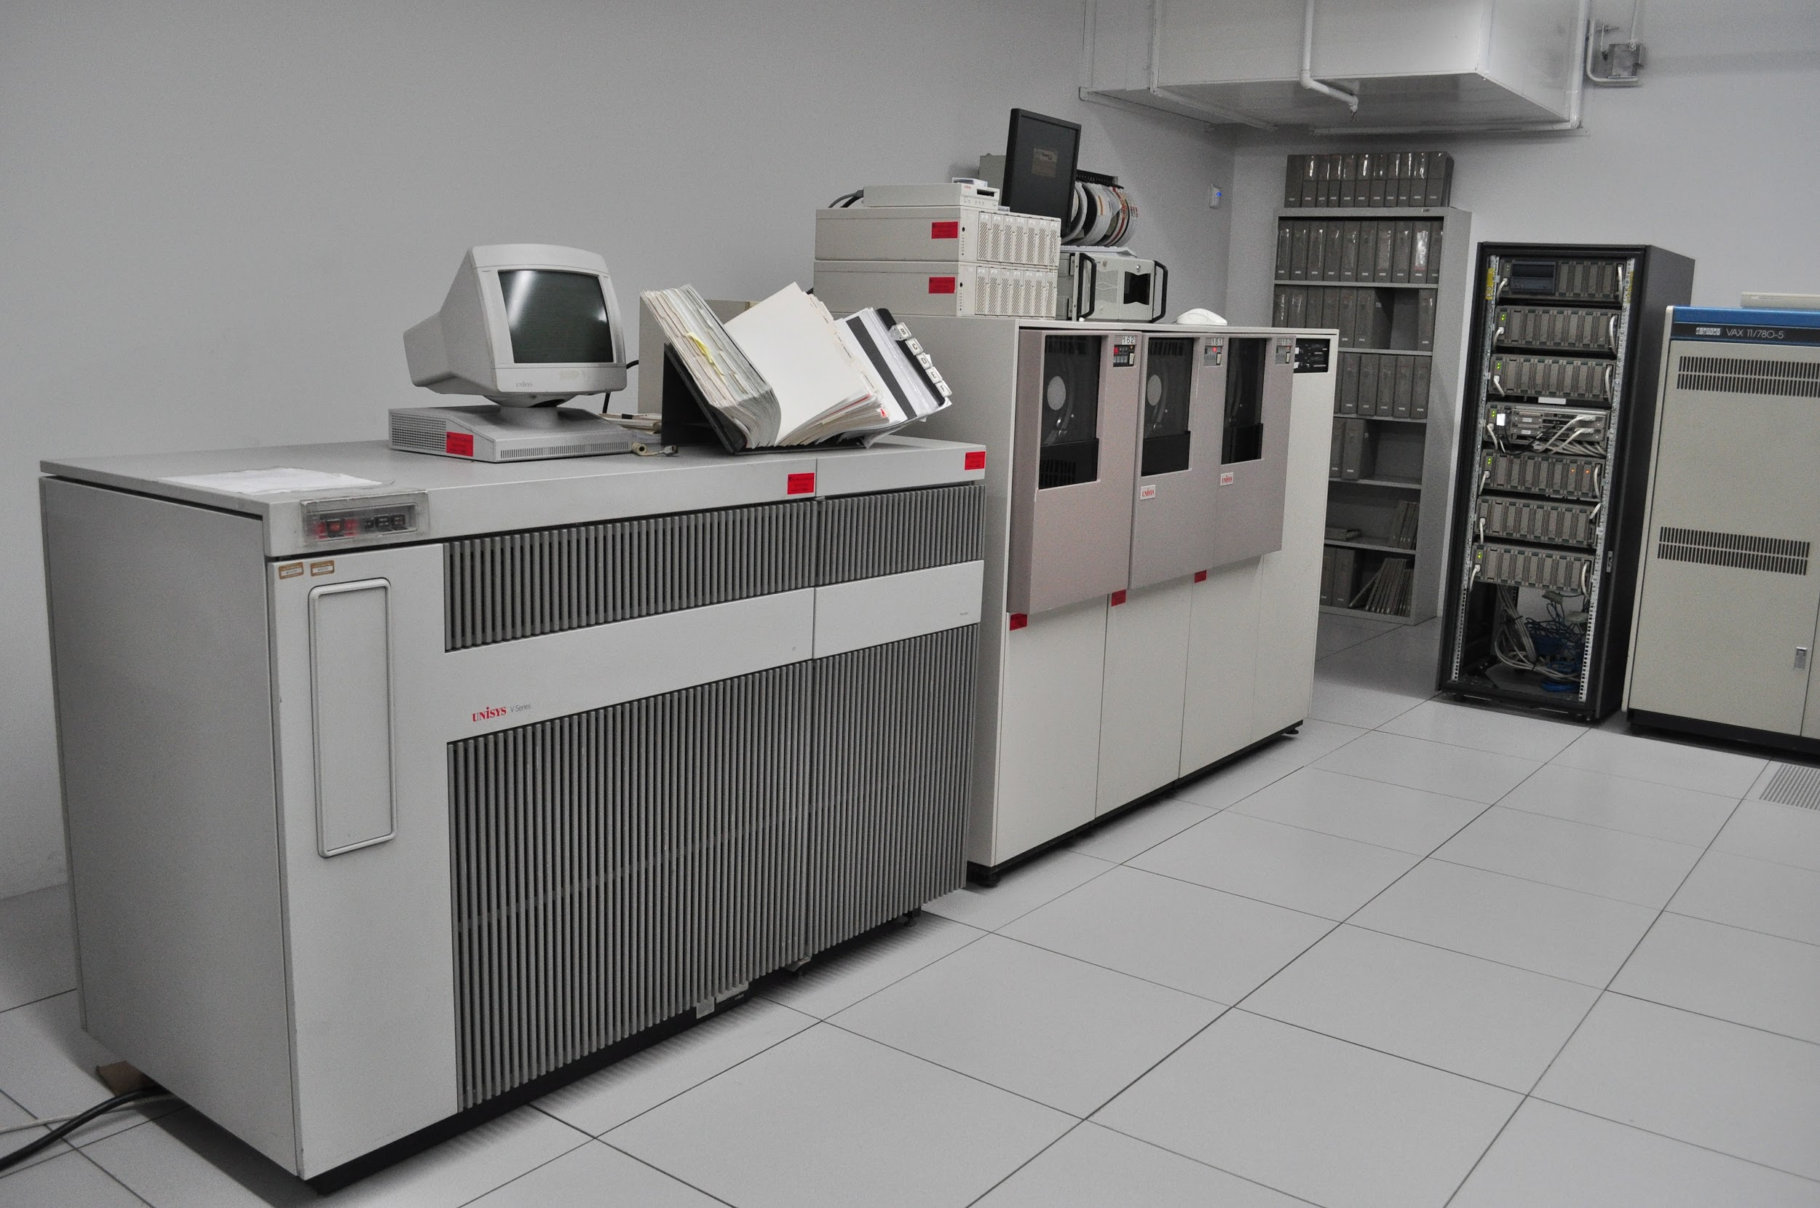
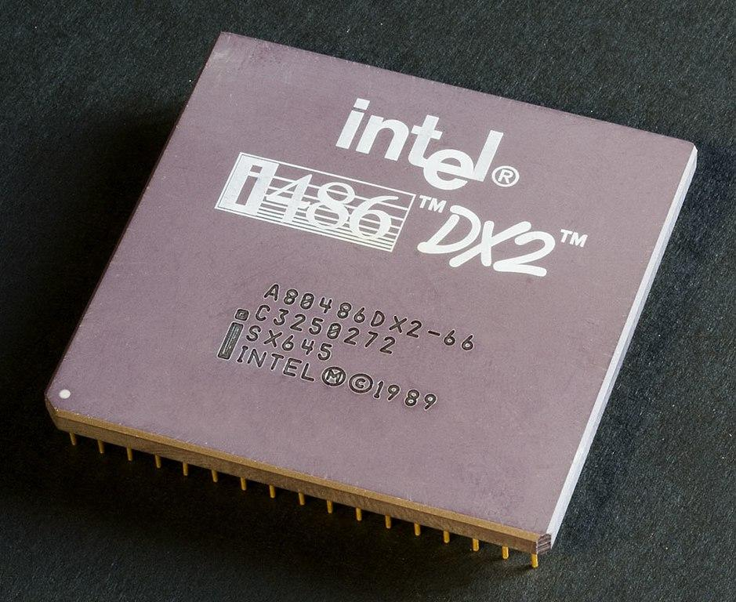
Free Software Operating System
Notes:
(notes) graphics???

Slide 17
The Contractual Closure on Data Governance
Open Source
Right to use published source code
Right to study published source code
Free Software
Freedom to modify published source code
Freedom to distribute modified software

Slide 18
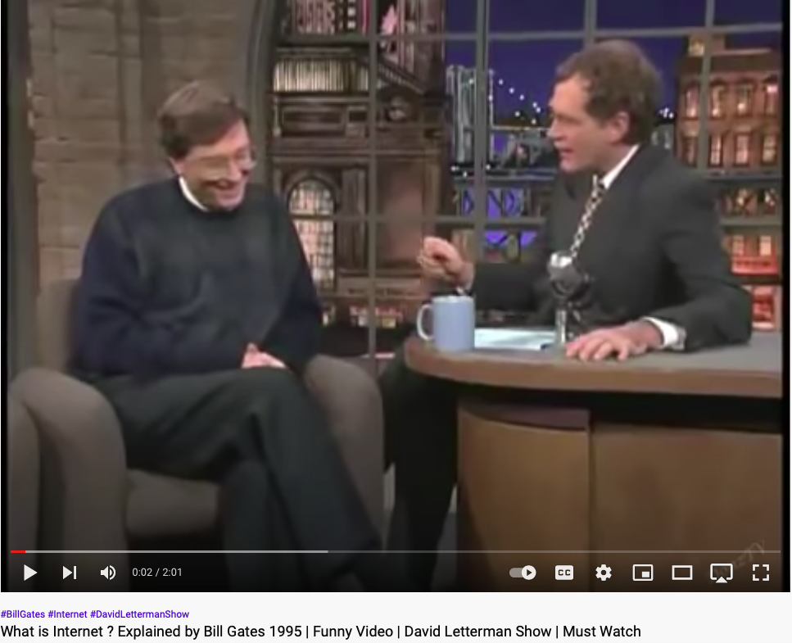
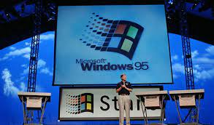
Incommensurable Ideas: What is Internet?
Notes:
(notes) graphics???

Slide 19




Browsers are the new operating systems
open-source
closed-source
Microsoft Edge
Chromium
open-source
closed-source
Brave
Google Chrome
Notes:
Wasm adds new capabilities for browsers as operating systems

Slide 20



The Universal Component for Data Organisation
Key
Hyperlink
Value
why directed link is a form of universal data abstraction

Slide 21
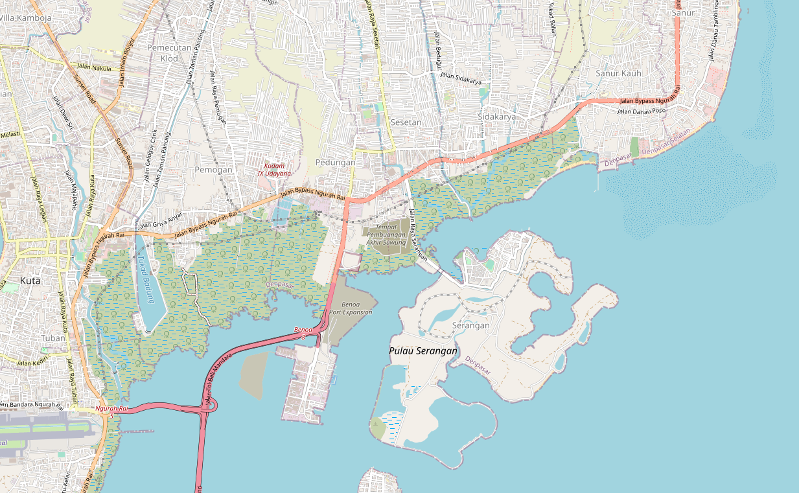
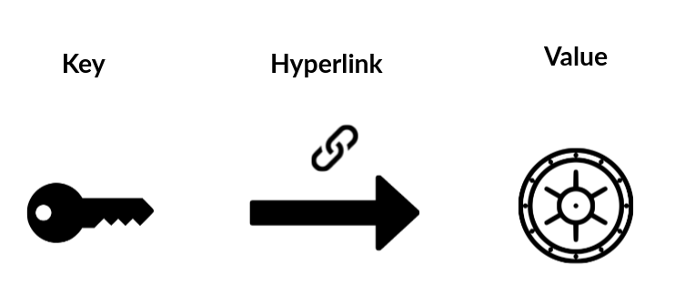
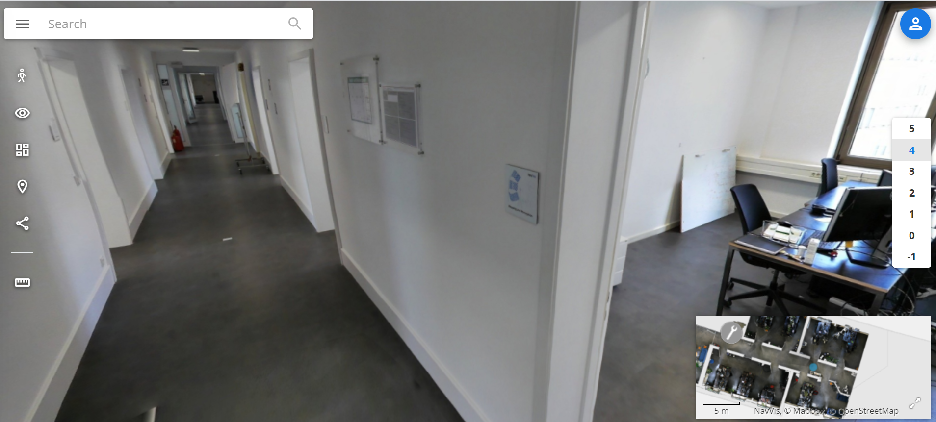
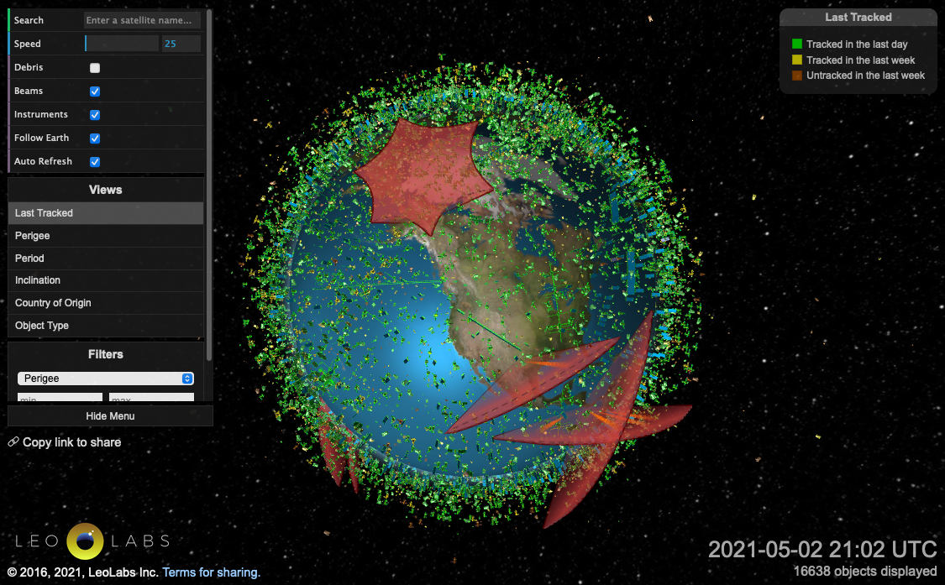
Data Organized as Multi-Dimensional Maps
Notes:
defined naming convention with defined name spaces
1 D map - hyperlink
2 D map - google maps
3 D map - jumping between multi-layer maps (VR Map in building)
4 D map - 3d Satellite map with time where we can go back and forth in time

Slide 22



Data Processing
Input
Algorithm
Output
All algorithms are representable as functions

Slide 23
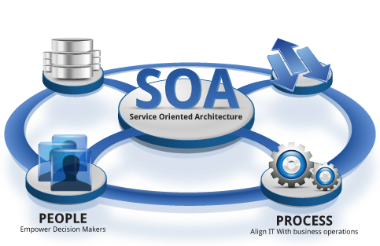

Data Deployment
Plan
Execution
Desirable Resource
Allocation
Actual Resource Allocation
All computing services can be managed as named resources
Extra Reading: SoA and the Bezos Mandate
a data serialization
standard for all computing services
Notes:
Open Sourced Tools like Kubernetes, continuously compares Actual Resource Allocation/Availability against the Desired Resource Allocation Specification

Slide 24




Types of Data
File
Page
Service
Data Governance (Namespaces)

Slide 25



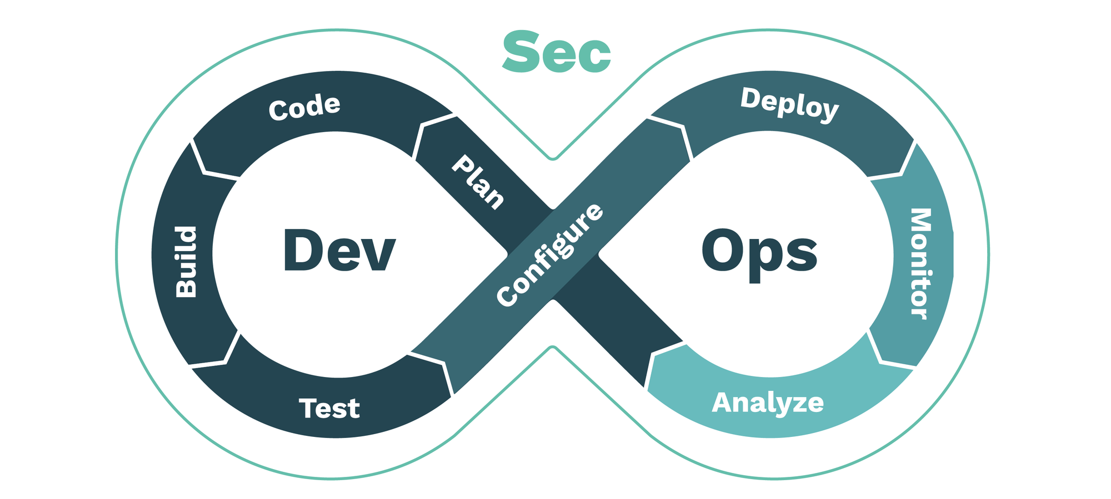
An Operating System on Networked Data
Data
that are legitimate to collect and fit everywhere
Page
Service
Validate
Browsers
Algorithms
that Correctly Synchronizes Data Content
Compute Power
to be cheaply replicated for fault tolerance
Develop
Deploy
File

Slide 26
Universal Data Abstraction
Cognitive Effectiveness can be enhanced by
a Unifying Data Abstraction

Slide 27
Key-Value Data Type is a Universal Abstraction
Mapped Domains | key/value | Examples
data/data | Inputs/Outputs | Dictionary/Tabulated Data
structure/structure | algorithm/source code | Logical Structures/Functions in Software Libraries
language/language | Specification/Implementation | Source Code/Executable Binary
Notes:
Soundness (Aliveness vs Safety = Correctness)
Precision (The result has a outer boundary)
Termination (It will come to completion)

Slide 28
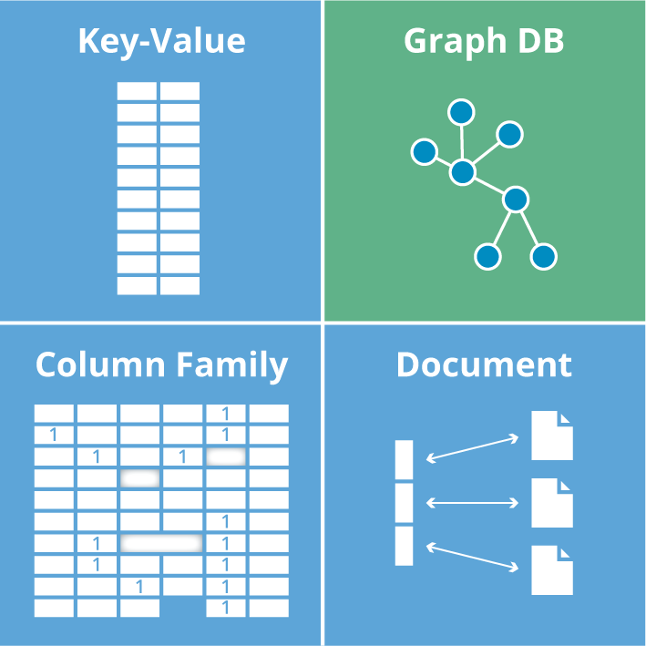
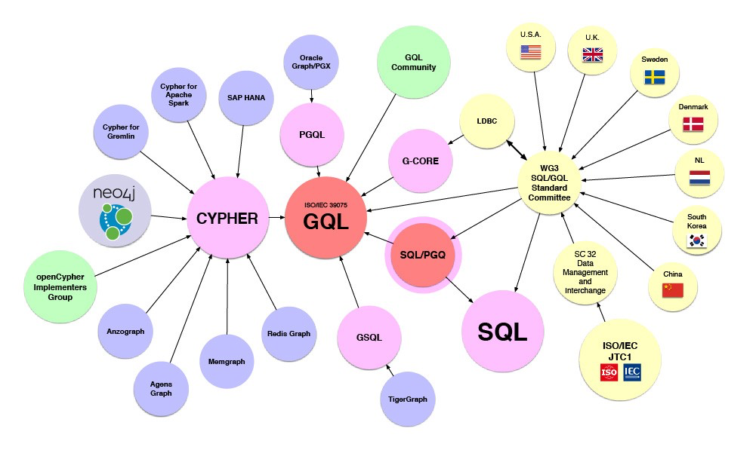






Encoded Symmetries in the IT industry
Image source: Graph Database for Beginners by Neo4j

Slide 29
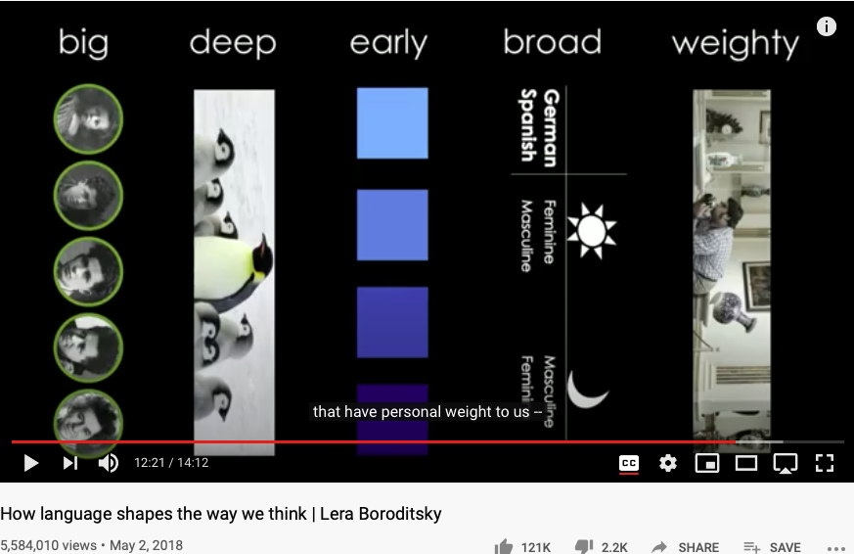
Language as a Cognitive Device
Huawei VP Mr. Yang Shaoqing
https://youtu.be/RKK7wGAYP6k

Slide 30
How does it relate to the book?
Pre-Science
Normal Science
Model
Drift
Model Crisis
Model Revolution
Paradigm Change

Slide 31
Key Ideas in Kuhn’s Dictionary
Incommensurable
不可通约的
Anomoly
Pre-Science
Normal Science
Model
Drift
Model Crisis
Model Revolution
Paradigm Change
Original Diagram from: https://www.thwink.org/sustain/glossary/KuhnCycle.htm

Slide 32
Key Concepts
Symmetries/Invariance, History/Time,
Data/Causal Relation/Key-Value/Dictionary,
Universal Data Abstraction

Slide 33
How are symmetries useful?
“Everything should be made as simple as possible,
but not simpler.”
Albert Einstein
Useful Data Abstraction:
A sound data practice that attains
precise,
yet terminable
Rrepresentation of Real World Events.

Slide 34



The Meta Vocabulary on “Cognitive” Models
Soundness
Precision
Termination
This is the meta glossary.
Notes:
(notes) add hyperlinks with definitions
Soundness: A Sound statement is a true statement whose composed sub-statements all accountably true, and the overall constructed statement also can be assessed to be true.
The degree of a statement to be sound is its Soundness assessment.
Precision (The result has a outer boundary)
Termination (It will come to completion)

Slide 35

Summary
Key-Value Pair (hyperlink) is a data structure that has universal expressiveness
Synonyms of Key-Value Pair:
Arrow, Function, Directed/Causal Relation, Map, Dictionary
Hyperlink provide a symmetry-breaking representational primitive, which can serve as the foundation of cognitive reasoning.
Encoded Symmetries are the cognitive keys in IT, AI, and Sciences.
Time-bound keys | Data Content Space (valuable assets) | Industrialized Tools
Past | Version-Controlled Files and Code | Git and Docker (data and source code)
Present | Dynamically Rendered Pages | Wiki (hyperlinked resources)
Future | Continuously Integrated, Delivered, and Deployed Services | Kubernetes/Nomad (service governance)

Slide 36
Content Outline for the semester
Cybernetics (Control and Communication)
Smart City and Internet of Things
Artificial Intelligence and its Social Impacts
Arts/Skills/Human Talents in the Digital Era
Student proposed Application Topics
Rehearsal
Final Reports and Celebration
A Cognitive Foundation grounded on Encoded Symmetries
Namespace Management
Biology, Physics, Math, Code is Law, and Society
Story Telling, Functions/Metaphors/Analogies
Writing, Accounting, Historical Data and Temporal Reasoning
Knowledge Representation in Wiki and Files
Recursion and Continuation (DevOps/CICD)
Midterm Reports by Students

Slide 37
References
Data Scott, Outline of a Mathematical Theory of Computation, Jan, 1977
Cousot & Cousot, Abstract Interpretation: A unified lattice model for static analysis of programs by construction or approximation of fixed points, Jan., 1977
Matt O’Dowd, The Geometry of Causality, PBS Space Time, last access: May 27, 2021, https://youtu.be/1YFrISfN7jo

Slide 38
Students Actions before Wednesday Sep 18, 2021
Register on toyhouse.wiki:81 with an account
Create a personal page with bio
Create a link in the personal page to your weekly learning report
Learn to use Mediawiki’s Hyperlink, Page/Template Transclusion, and Category features
Start writing your learning report.
Every week should include a Logic Model (apply Logic Model template)
500 words or more per week

Slide 39

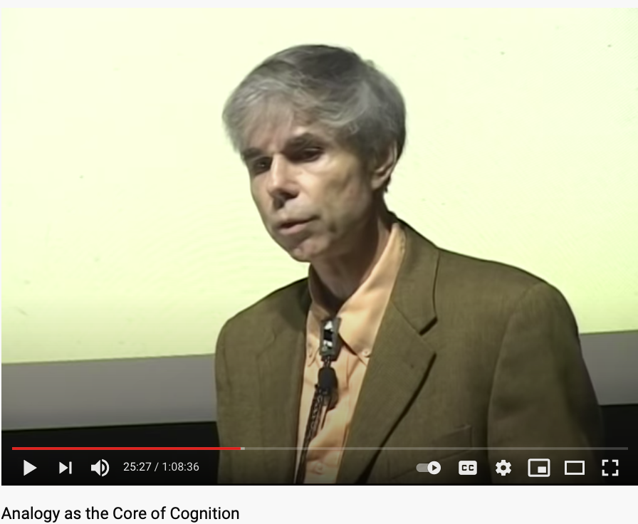
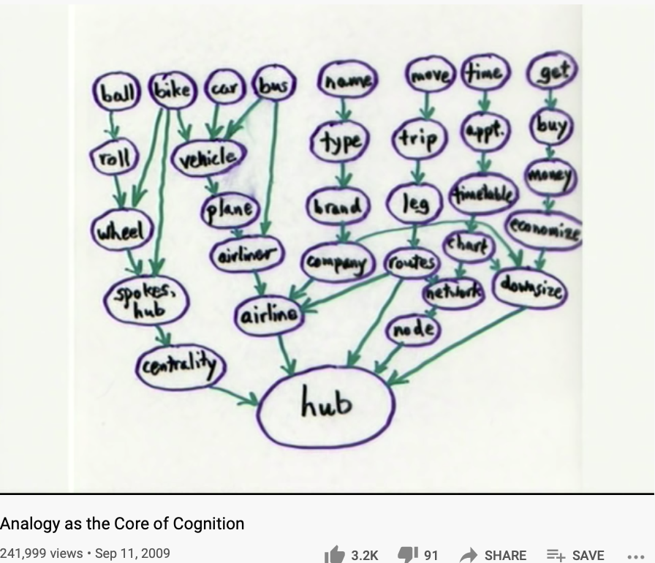
Metaphors make up the Foundation of Cognition
https://youtu.be/n8m7lFQ3njk

Slide 40

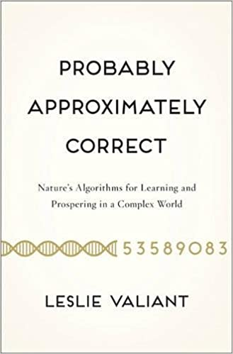
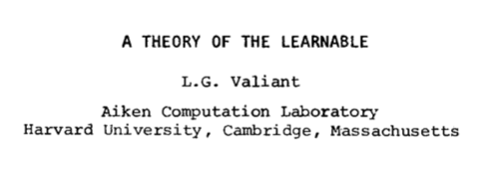
The Learnability Hypothesis by Leslie Valiant
The machines can provably learn whole classes of concepts. Furthermore these classes can be characterized.
The classes of concepts are appropriate and nontrivial for general purpose knowledge,
The computational process by which the machines deduce the desired programs requires a feasible (i.e. polynomial) number of steps.
Turing Award (2010)
Communications of the ACM. 27 (11): 1134–1142. doi:10.1145/1968.1972

Slide 41
Computationally-Enhanced Cognitive Foundation Transcending the Boundaries of Human, Machines, and Knowledge Disciplines
Huawei VP Mr. Yang Shaoqing

Slide 42
AUDIENCE
Registered Students@THU
A course FOR ALL Disciplines
Fulfills Liberal Arts Req. (通识课)

Slide 43
AUDIENCE (self-intro)
Everyone speak for 120 seconds
Your name
Department Association
Why do you choose this class?
What do you expect to learn?
What is your strongest trait?
Any knowledge related to cognitive science?

Slide 44
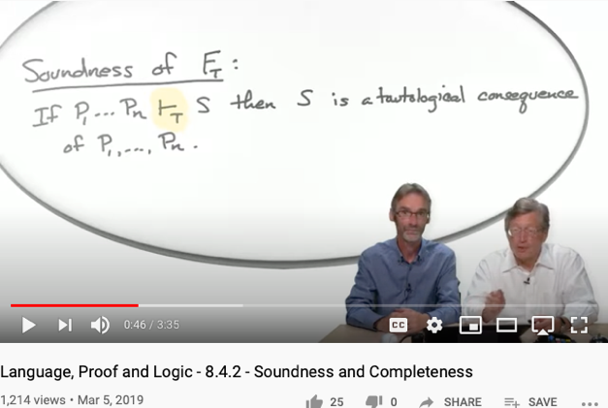
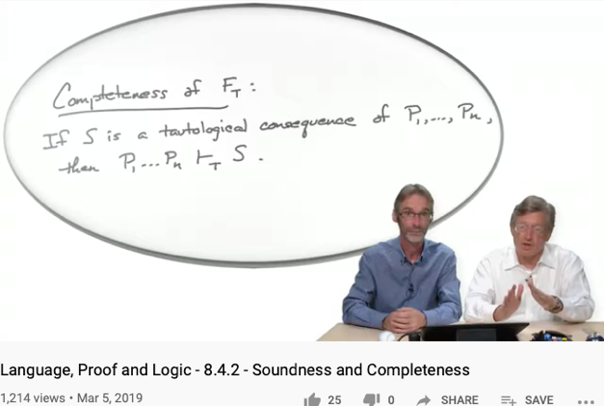
Soundness
Completeness
Every provable statement is true
Every true statement is provable
Cited from : Soundness and Completeness: With Precision on news.ycombinator.com
https://youtu.be/3hspKYIn5ds?t=29
https://youtu.be/3hspKYIn5ds?t=162

Slide 45
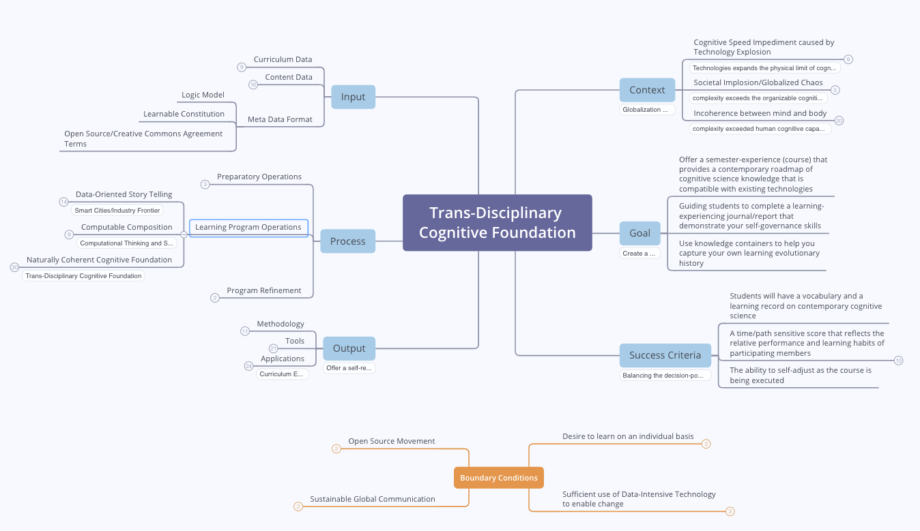
Course Outline

Slide 46
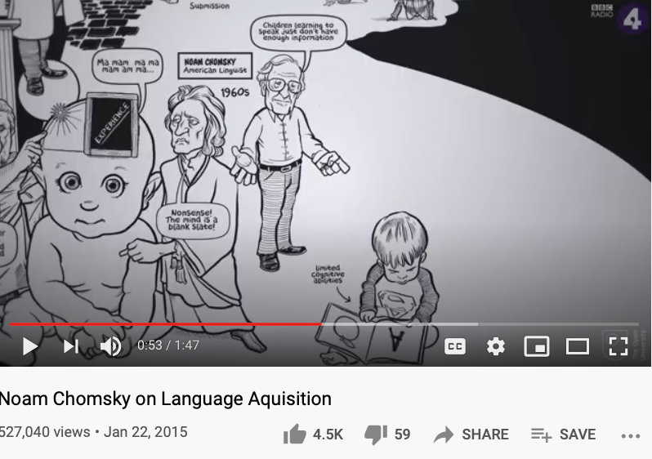
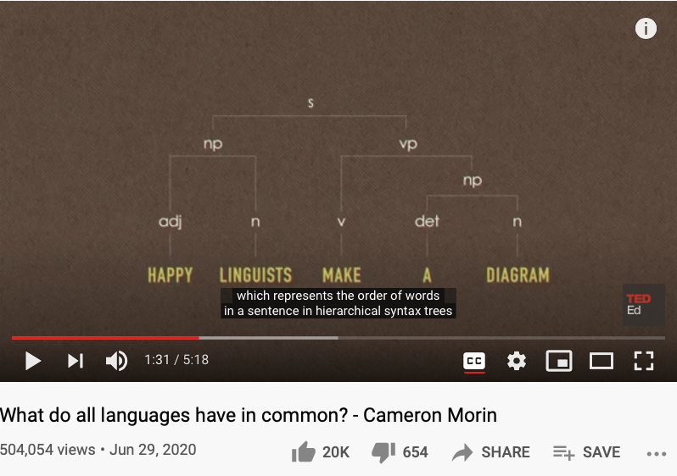
“Modern” Cognitive Science
Is there a finite set of actions to verify the existence of self?
Is there a “universal grammar” that is applicable to all?
https://www.openculture.com/2019/02/a-brief-animated-introduction-to-noam-chomskys-linguistic-theory-narrated-by-the-x-files-gillian-anderson.html

Slide 47
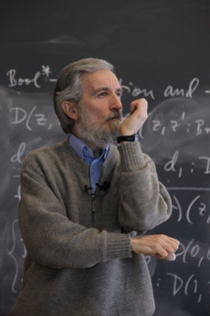
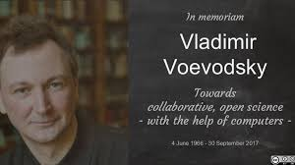
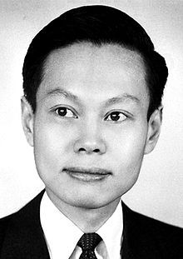


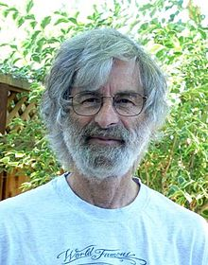

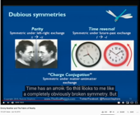

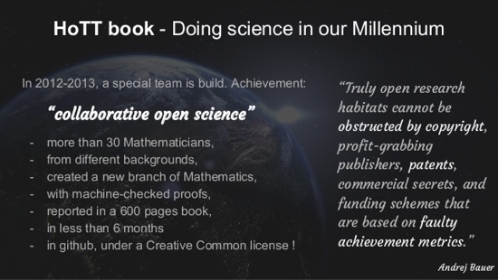

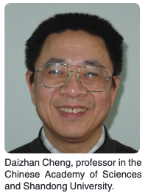

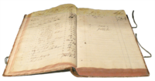

From History, Logic, Philosophy, Math, Physics, to Computation, Communication, Control, and Society
Huawei VP Mr. Yang Shaoqing
Per Martin-Lof
Leslie Lamport, 2013 Turing Award, Distribute Systems and Temporal Logic
Saunders Mac Lane

Slide 48
What are the formal foundations?
Formalized Languages, “Universal, Abstract Grammars”
Fundamental Theorems of Arithmetic, Algebra, and Calculus
The notion of Equivalence: As defined by Voevodsky’s Univalent Foundation
Category Theory Foundation: Universal Properties and Homotopy Type Theory
Intuitive Nomenclatures
We understand the world by assigning proper names in convenient formats (Logic Model)
Application-specific controlling, computing, and communicating mechanisms (Cybernetics)

Slide 49
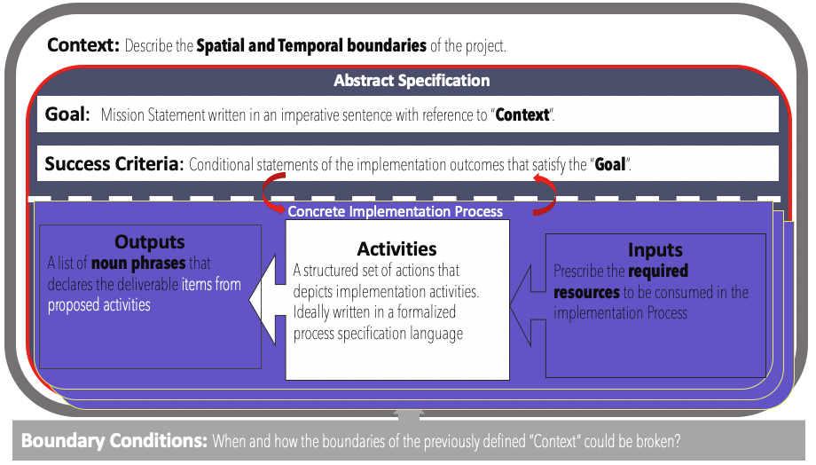
Logic Model (OKRs) as a Transdisciplinary Foundation

Slide 50

Objective & Key Results (OKRs)
Objectives
A statement of a broad goal,
Usually qualitative in nature.
Key Results
A statement that measures
Achievement of a given objective

Slide 51
Abstraction
Concretization
Why is abstraction useful?
Allow reuse through universal properties
Avoid resource conflicts
Scale free and domain neutral
Generalizing concrete experience?
Make analogies in localized contexts
Engage sensible metaphors
Define terms and boundaries
A well-defined set of Actions and iterative Branching Strategies
A Roadmap of composable activities
Sequencing and timing conditions
Explicitly state dependencies and resource requirements
Namespace Management

Slide 52



Reference Materials on OKRs

Slide 53
Context: Describe the Spatial and Temporal boundaries of the project.
Contextualized Objectives
Goal: Mission Statement written in an imperative sentence with reference to “Context”.
Success Criteria: Conditional statements of the implementation outcomes that satisfy the “Goal”.
Concrete Implementation Process
Process that Delivers Key Results
Outputs
A list of noun phrases that declares the deliverable items from proposed activities
Activities
A structured set of actions that depicts implementation activities.
Ideally written in a formalized process specification language
Outputs
A list of noun phrases that declares the deliverable items from proposed activities
Activities
A structured set of actions that depicts implementation activities.
Ideally written in a formalized process specification language
Inputs
Prescribe the required resources to be consumed in the implementation Process
Inputs
Prescribe the required resources to be consumed in the implementation Process
Boundary Conditions: When and how the boundaries of the previously defined ”Context” could be broken?

Slide 54


Context: Modern Technologies challenges the cognitive capacities of human and human societies.
Goal: Provide a methodical cognitive framework to leverage contemporary technologies and cognitive science content.
Success Criteria: Enable students to utilize cognitive methods and tools, while measuring learning outcomes accordingly.
Outputs
Cognitive Science Report
Summarize your methods
Digitally published Learning Reports
Behavioral Data (on MediaWiki)
Personally chosen application areas
Biology, Physics, Math, Literature, Social Science, Arts, …
Activated Processes
1. Course Preparation
Content and Process design
2. Learning Program Execution
16 week exercise
3. Program Refinement
Continuous Adjustments
Periodic Refinements
Inputs
Curricular Structure
Coherent with university-level curriculum design
Content Data
A time-oriented knowledge(data) representation framework
Meta Data Formats
Logic Model(OKRS), Learning Report Format, Universal Resource Locators
Boundary Conditions: Personal willingness to adopt a new cognitive foundation, and intensity of practicing this new skill

Slide 55
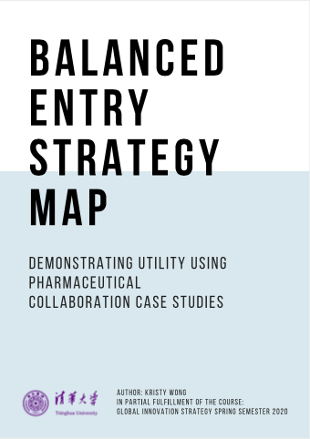
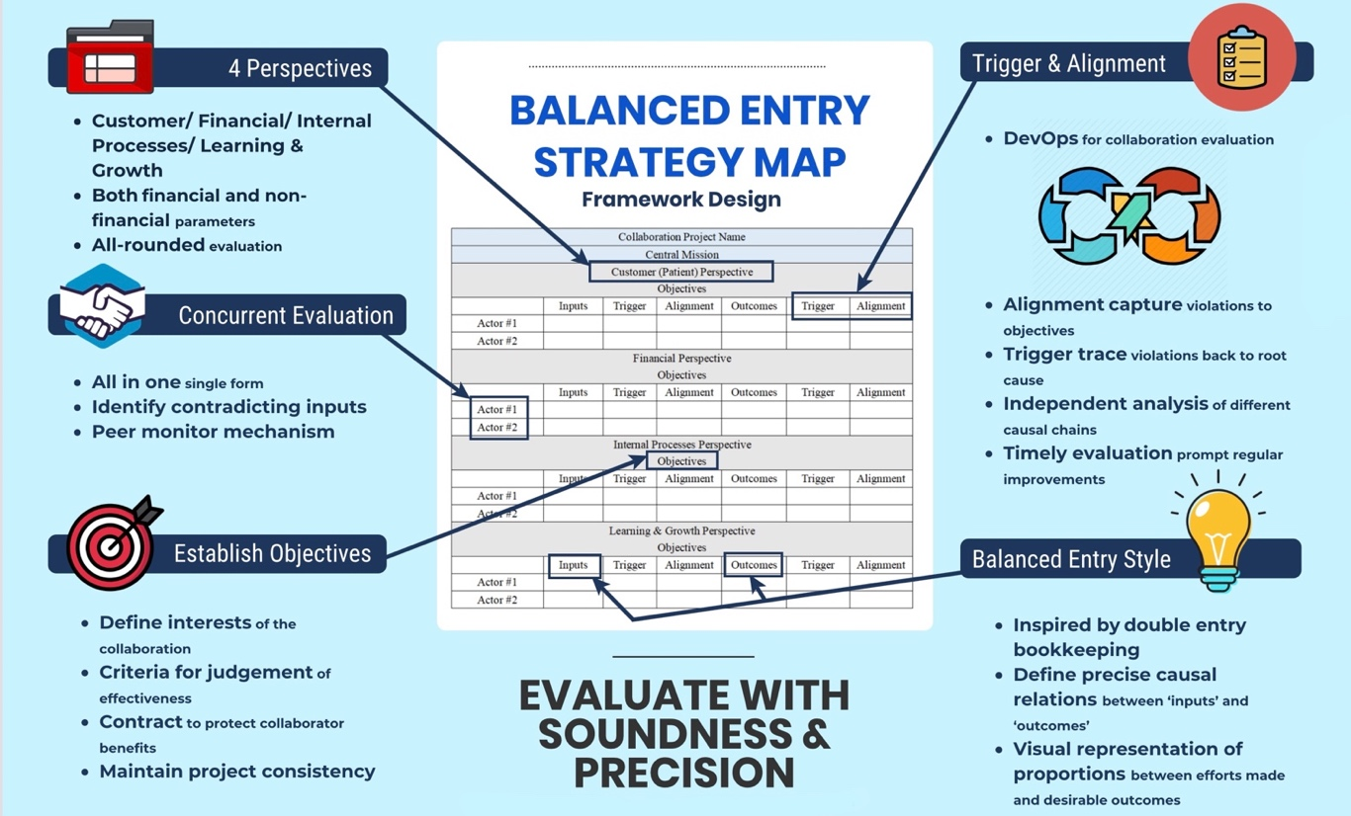
Introduce Balanced Strategy Map (BSM) by Kristy Wong A new kind of Logic Model & a variant of OKRs (Spring 2020)

Slide 56


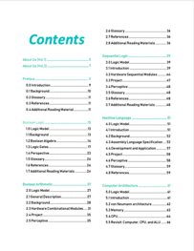


A course that invite you to investigate THINKING at multiple scales create and publish your own ideas in a digital publishing workflow…

Slide 57

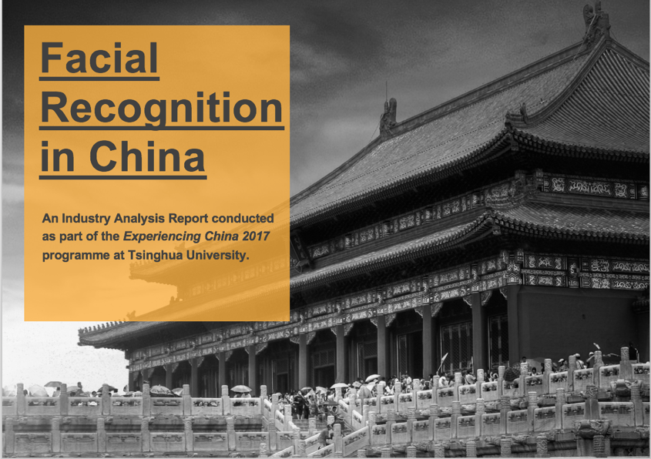

2018 International Summer Program @ Tsinghua Experience a publishing workflow using DevOps

Slide 58

Measurements in Context
Spacetime as the foundational metrics
A statement that outlines the perimeter of project concern
Focus on contemporary situations that are most critical in directing and justifying certain goals
Remind yourself about the relevancy of potential actions
For a semester long course, plan for actions that can be finished in a few months.
Identify a desired scope of your cognitive actions ...
Image source:
Ask Ethan: Is Spacetime Really A Fabric?

Slide 59


What makes a Sound method?
A natural equivalence that is
up-to-isomorphism to relevant domains.
A method that matches your application context,
without the losing scope of possible alternatives.
Henri Poincare is main figure in modern topology and physics in general.

Slide 60

How to measure with generality?
An important foundation in quantitative measurements!

Slide 61


Universality in Textbook

Slide 62




Incompleteness Theorem: Limits of Math/Logic
Image source: newyorker.com
https://youtu.be/V9ohtKameio

Slide 63

CONTEXT that Narrows your scope of Objectives
GLOBALIZATION AND INDUSTRIALIZATION CHALLENGED THE BOUNDARY OF HUMAN COGNITIVE POWERS
THE SPEED OF CHANGES EXCEEDS MENTAL CAPACITY
Societal Implosion & Globalized Chaos
Incoherent minds and body
overwhelmed by new knowledge
lost of self-worth

Slide 64




Speed is the Dominant factor in Decision Making
A NEW Cognitive Foundation is needed to enable
Sufficiently FAST
collective learning!

Slide 65

Power of a Dominant Design/Protocol
“Theoretical framework: dominant category and dominant design during the industry life cycle. During the industry life cycle, the number of categories will increase before the number of firms increases. The emergence of the dominant category occurs as the number of categories begins to decrease. This point in time marks the opening of the window of opportunity for entry, whereas the emergence of the dominant design marks the closing of the window of opportunity”
Excerpt from the article:
Perfect timing? Dominant category, dominant design, and the window of opportunity for firm entry

Slide 66





The World has changed … Ways to conduct business have changed …
https://en.wikipedia.org/wiki/George_Hotz

Slide 67


Kuhn Cycle: as the ticking clock
Normal Science
Model
Drift
Model Crisis
Model Revolution
Paradigm
Change
Emerging cases or
systematic attacks
Product Development Process
in five stages
Commit
Build
Test
Stage
Deploy

Slide 68
Learning Outcome: A Namespace Management Methodology
Normal Science
Model
Drift
Model Crisis
Model Revolution
Paradigm
Change
Emerging cases or
systematic attacks

Slide 69


Three Scales of Time
Mesoscopic：
Localized Adjustments
Time Stamp
Macroscopic:
Five Stages of Evolution
Normal Science
(commit)
Model
Drift
(build)
Model Crisis
(test)
Model Revolution
(stage)
Paradigm Change
(deploy)
Microscopic：
Process Data and Summative Result
Time Stamp

Slide 70
Time Stamped Data Preserve Event Ordering Information
Normal Science
(commit)
Model
Drift
(build)
Model Crisis
(test)
Model Revolution
(stage)
Paradigm Change
(deploy)
Time Stamp
Time Stamp
Time Stamp
Time Stamp

Slide 71

Blockchain, Distributed Ledger Technologies: Time is Money
https://www.investopedia.com/terms/b/blockchain.asp

Slide 72






A Model of Collective Cognitive Processes
(students/teachers)
(Smart) Social Contract Execution
Traders
Miners
Coders
(Consumers/Distributors)
Three Asynchronous
Clocks in their respective
Communities
Version Upgrade
Production Code
Function Requests
Customer Crisis
Feature Revolution
Emerging cases or
systematic attacks
(Artists/Creative Projects)
(Administrators/Witnesses)
Perform Checking
receive confirmation
commit transaction
(Content Producers/Product Designers)
(Accountants/Lawyers)

Slide 73

Smart Contract with Observable Historical Data
ISDA: International Swaps and Derivatives Association

Slide 74



Legal Algorithms: Code is Law

Slide 75
Learning Process as a Publishing Workflow
Traders
（students/teachers）
Miners
（Administrators/Witnesses）
Coders
(Artists/Creative People)
(Consumers/Distributors)
(Content Producers/Product Designers)
(Accountants/Lawyers)

Slide 76

Learnability of a Multi-Scale DevOps Process
Traders
（students/teachers）
Miners
（Administrators/Witnesses）
Coders
(Artists/Creative People)
Sec
(Consumers/Distributors)
Dev
Ops
(Content Producers/Product Designers)
(Accountants/Lawyers)

Slide 77

Goal
Stating objectives in scope
Use imperative sentence to express intent. Be active!
Draw on forces that are present in the context, align your argument with contextualized information
Preparing a proposition that has concrete and verifiable outcomes
For example: Colonizing human in space…
Identify a desired scope of your cognitive actions ...
Image sources:
Ask Ethan: Is Spacetime Really A Fabric?

Slide 78



GOAL
Introduce students to a domain-independent cognitive science results according to the time-based linguistic framework.
Use of the Natural Units as the core linguistic elements
A Social Contract(OKRS) for Learner’s self governance
Create a knowledge container for everyone
Capture knowledge using a Mediawiki Database
Compile personal knowledge into a publication

Slide 79

Success Criteria
A set of conditional statements that qualifies the success criteria to achieve the stated goal(s)
Conditional statements that can be judged to yes/no results
Certain success criteria can be measured in terms of degree of success (portions accomplished)
Success measures maybe assessed in terms of Time and Entropy (probability of success) values.

Slide 80
Success Criteria
Elevate Students’ Knowledge Orchestration Strategies up to the level of necessity presented by contemporary industrial complex
A foundational learning strategy that will continue to work as technologies progresses and complexity/entropy increases
Knowing the essence of data management under a dynamic context
Knowing how namespace management strategies and tools can be used to manage any projects (version control)

Slide 81
What would your gain by taking this Course?

Slide 82

Output
Deliverables at the end of Project
A list of deliverables that are encoded in a generally acceptable namespace
Define outputs in precise technical terms, using a scalable namespace management tool, such as MediaWiki
Output content should be marked with time and contributors’ non-repudiable signatures
Image Source: A Blockchain-Based Notarization Service for Biomedical Knowledge Retrieval
https://www.sciencedirect.com/science/article/pii/S2001037018300400

Slide 83



A Strategy to Stretch Cognitive Model
Enabled by modern Data Infrastructures, modern curriculum may
Be constructed by new Methods, Tools and Applications
Cognitive Model Extension

Slide 84


Driven by Linguistic/Cognitive Science
The Methods, Tools and Applications are based on
Linguistic/Cogntive and Computing Sciences
Cognitive Model Extension
“Mathematics is the art of given the same name to different things.”
― Henry Poincare

Slide 85

Representing Knowledge as Domain-Specific Languages (DSL)
Utilizing Computing Science to define
Vocabulary,
Syntactical Rules
Pragmatic Use Cases of the DSLs
Data Content is categorized in terms of
Process(Learner Behavior) Data,
Publishable Data (managed by participants)
Meta Data (formats or content index)

Slide 86


Organized Activities
A well-defined set of Actions and iterative Branching Strategies
A Roadmap of composable activities
Sequencing and timing conditions
Explicitly state dependencies and resource requirements

Slide 87
DevOps/CICD as the general process pattern
Image courtesy: Paladion Corporation Website https://www.paladion.net

Slide 88

Instrumentation of DevOps
Image courtesy: PETSEBAN on NearCoding

Slide 89



GitOps: Git as the Single Source of Truth

Slide 90

A Self-Optimizing Process
A common organizational template for
Learning organizations with tools and
Well-formed data structures
Broadly categorize courses into 3 types
Macro/Meso/Micro-scopic reasoning
All courses can find reusable elements
All programs should have two kinds of
Corrective/adjustment actions.
During/between program executions.

Slide 91
A Cognitive Learning Program that utilizes Contemporary Tools

Slide 92





Inputs for Collective Cognizance
A domain-independent knowledge model (curriculum data) for
learning organizations with data collection tools and
statistical data analysis practices (namespace management)
Knowledge Content Data such as
Biology, Physics/Chemistry, Math/Computing
To be taught in ”schools”.
A consistent format to be shared by all content
publishers in the community.

Slide 93

“Reliable” Inputs: The Rosetta Stone of Cognizance
https://math.ucr.edu/home/baez/rosetta.pdf

Slide 94

Natural Units
https://en.wikipedia.org/wiki/Natural_units

Slide 95


Foundational Building Blocks?
“… we know that the statement that the Planck length is the smallest possible length is on shaky ground. “
- Dr. Don Lincoln
Related paper links provided by Don Lincoln
Don Lincoln article in Fermilab Today: “Planck length, minimal length” https://www.fnal.gov/pub/today/archive/archive_2013/today13-11-01_NutshellReadMore.html
Frank Wilczek’s paper on absolute units http://ctpweb.lns.mit.edu/physics_today/phystoday/Abs_limits388.pdf
Mead and Wilczek’s public conversation http://ctpweb.lns.mit.edu/physics_today/phystoday/Alden-Repsonse323.pdf
Energy conservation in general relativity: John Baez https://math.ucr.edu/home/baez/physics/Relativity/GR/energy_gr.html
Energy conservation in general relativity: Sean Carroll https://www.preposterousuniverse.com/blog/2010/02/22/energy-is-not-conserved/
English Translation link provided by Sabine Hossenfelder
http://backreaction.blogspot.com/2007/07/planck-scale.html

Slide 96


cell structure/functions and operating systems
Image courtesy: Riyaz Hyder on Botmetric November 2, 2017

Slide 97

A metaphorical connection between anatomy and application development process
Image courtesy: Riyaz Hyder on Botmetric November 2, 2017

Slide 98





Use Physiology as a Domain-Specific Example
Image courtesy: Riyaz Hyder on Botmetric November 2, 2017

Slide 99

Prof. Elkhonon Goldberg and the Happy Digital X Project of THU

Slide 100



A metaphorical connection between biology and social sciences

Slide 101

Ricardian Contract Socially Binding Digital Twin

Slide 102
Context: Describe the Spatial and Temporal boundaries of the project.
Abstract Specification
Goal: Mission Statement written in an imperative sentence with reference to “Context”.
Measurable Effects: Conditional statements of the observable implementation outcomes that satisfy the “Goal”.
Concrete Implementation Process
Outputs
A list of noun phrases that declares the deliverable items from proposed activities
Activities
A structured set of actions that depicts implementation activities.
Ideally written in a formalized process specification language
Inputs
Prescribe the required resources to be consumed in the implementation Process
Boundary Conditions: When and how the boundaries of the previously defined ”Context” could be broken?

Slide 103
Sample Logic Model
Context: A two vessel system containing moving particles of varying speeds.
Abstract Specification
Goal: Let particles moving at speed higher than average to the left vessel, and lower than average particles to the right vessel.
Measurable Effects: Total average speed of all particles, and final distribution of moving particles.
Concrete Implementation Process
Left Vessel
Particles moving about from initial condition to the end of the last action of Maxwell’s Demon
Activities of
Maxwell’s Demon
Right Vessel
Particles moving about from initial condition to the end of the last action of Maxwell’s Demon
Continuously observe the Average Speed of all Particles
Move faster than average particles to the left, and the others to the right
Boundary Conditions: The Maxwell’s Demon’s decision powers can be externally supplied from outside the two vessel system.

Slide 104

Not Information Asymmetry, but promote the Principle of Information Symmetry

Slide 105

Open and then Free
Open Source
Right to use publicly available technologies and other resources in the learning process
Right to resolve conflicts in a dynamic context in digitized space
Freedom to make decisions related to one’s personal digital assets
Freedom to express one’s opinions
Free Software
Founder of Free Software Foundation, and Creator of GNU/Linux. Image credit: Wikipedia
Paraphrased from “Free Software, Free Society” by Richard Stallman

Slide 106


Human Physiology and Modern Data Infrastructures Checks and Balances
Data Plane
Control Plane
Data Plane
Control Plane

Slide 107



Code is Law

Slide 108

Spacetime Representations for a Collective Conscious
Far
Space
near
before Time after

Slide 109

Kuhn Cycle as a half cycle of DevOps
Normal Operations
Drifting Norms
Operational Crisis
User Revolution
Version Upgrade
Emerging cases or
systematic attacks

Slide 110



A linguistic approach to Transdisciplinary Cognitive foundation

Slide 111

A Smart way to Govern Activities in Space-Time
Transform everything into Data
(Namespace Management)
Ongoing Development
RICH 70 Tsinghua SEA Cloud Forum, Sep 14, 2020
H. E. Bambang Brodjonegoro,
Minister of Research & Technology, Indonesia
Image credits: http://verses.io

Slide 112



Time sensitive data sources
https://news.ycombinator.com/
Image courtesy: Riyaz Hyder on Botmetric November 2, 2017

Slide 113
GitOps: Git as the Single Source of Truth

Slide 114




Proofing Correctness across time scales

Slide 115





Prior Publications by relevant Course Series
Hyperlinks
between
Documents
Digital Asset
Backup/
Tracking/
Exchange

Slide 116





An Open Source Tech in the Making
Library of
Linked Knowledge
(Data Plane)
Library of Executable Algorithms
(Control Plane)

Slide 117

Representing Collective Consciousness based on the Principe of Information Symmetry
Public Domain Data
Contractual Data
Private
Data
Sec
Dev
Ops
Spiritual
Ecological
People
“Language is an organ of perception, not simply a means of communication”
― Julian Jaynes

Slide 118



An example of Namespace Management

Slide 119




Quiz: Our Cognitive Strategy stands on what 3 things?
Sec
Dev
Ops

Slide 120



Our Cognitive Strategy stands on three legs
A Method based on
Linguistic Theory (name management)
Sec
A Tool Stack based on
Continuous Integration and Git/Wiki
Dev
Ops
Applications driven by available data sources,
organized by a domain-independent namespace.

Slide 121
Governance in Cyber-Physical Spaces
John Locke’s Theory of Governance
All Men(Persons) are Created Equal
Certain Basic Rights Exists Independent of Government
Government Exists to Protect those Rights
Cyberspace Governance
All User Accounts can be Equally Created
Users may do anything Independent of Cyber-Government
Cyber-Government exists to enable user rights without Breaking the Cyber-Physical System
System Engineering | John Locke | Cyberspace
Correctness | All Men are Created Equal | All Accounts are Created Equal
Liveness | Certain Basic Rights exists Independent of Government | User actions are Independnet of Cyber Governance
Safety | Government exists to Protect those Rights | Cybersecurity exists to prevent users break the System

Slide 122

Potential Barriers

Slide 123

Abstraction
Concretization
Motivation
Symmetry over all spacetime
Only encode patterns
Self-contained yet Transcendental
Definition
Local context breaks symmetry
Patterns requires cognitive efforts
Influenced by external factors
A well-defined set of Actions and iterative Branching Strategies
A Roadmap of composable activities
Sequencing and timing conditions
Explicitly state dependencies and resource requirements
Namespace Management

Slide 124
Students Actions before Wednesday Sep 18
Register on toyhouse.wiki:81 with an account
Create a personal page with bio
Create a link in the personal page to your weekly learning report
Learn to use Mediawiki’s Hyperlink, Page/Template Transclusion, and Category features
Start writing your learning report.
Every week should include a Logic Model (apply Logic Model template)
500 words or more per week

